Slide 1
Recurrent neural networks (RNN) Encoder-Decoder

Slide 2
Overview
The Encoder-Decoder LSTM is a recurrent neural network designed to address sequence-to-sequence problems, sometimes called seq2seq.
Sequence-to-sequence prediction problems are challenging because the number of items in the input and output sequences can vary.
For example, text translation and learning to execute programs are examples of seq2seq problems.

Slide 3
seq2seq model
Sequence to Sequence model aims to map a fixed length input with a fixed length output where the length of the input and output may differ.
seq2seq takes as input a sequence of words(sentence or sentences) and generates an output sequence of words.
It does so by use of the recurrent neural network (RNN).
A sequence to sequence model lies behind numerous systems which you face on a daily basic.
seq2seq model powers applications like Google Translate, voice-enabled devices and online chatbots.

Slide 4
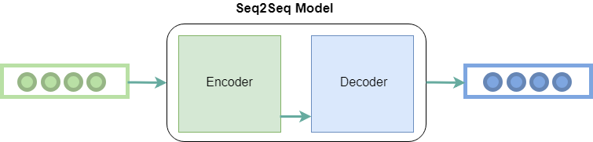
Sequence to Sequence Model

Slide 5
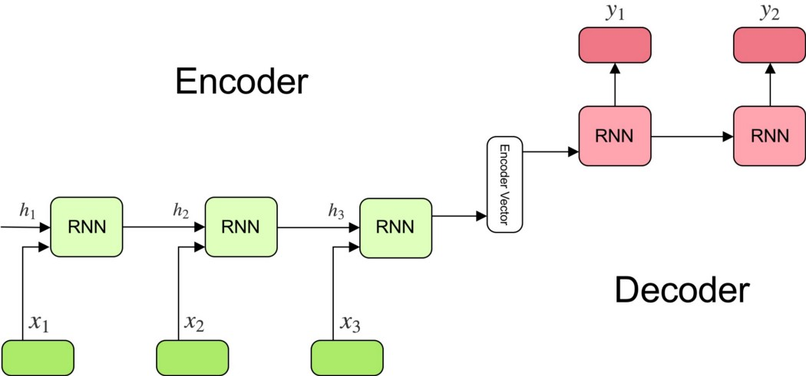
Sequence to Sequence Model working

Slide 6
Encoder
A stack of several recurrent units where each accepts a single element of the input sequence, collects information for that element and propagates it forward.
Encoder is for reading the input sequence and encoding it into a fixed-length vector.
Each vector represents the current word and the context of the word.
In question-answering problem, the input sequence is a collection of all words from the question.

Slide 7
Encoder Vector
This is the final hidden state produced from the encoder part of the model.
This vector aims to encapsulate the information for all input elements in order to help the decoder make accurate predictions.
It acts as the initial hidden state of the decoder part of the model.

Slide 8
Decoder
A stack of several recurrent units where each predicts an output a time step t.
Each recurrent unit accepts a hidden state from the previous unit and produces and output as well as its own hidden state.
In question-answering problem, the output sequence is a collection of all words from the answer.
Each word is represented as y_i where i is the order of that word.
Softmax is used to create a probability vector which will help us determine the final output (e.g. word in the question-answering problem).

Slide 9
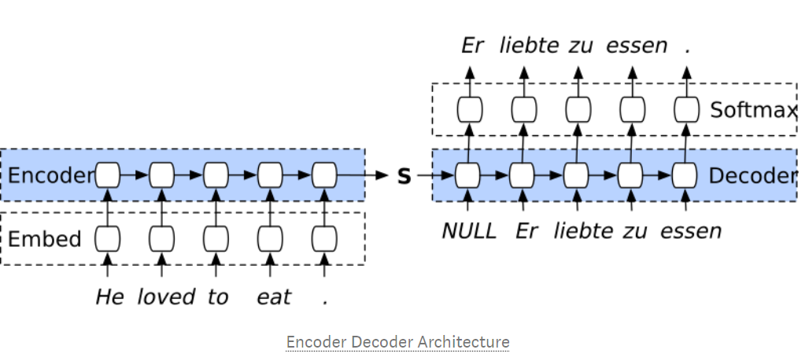
Encoder Decoder Architecture

Slide 10
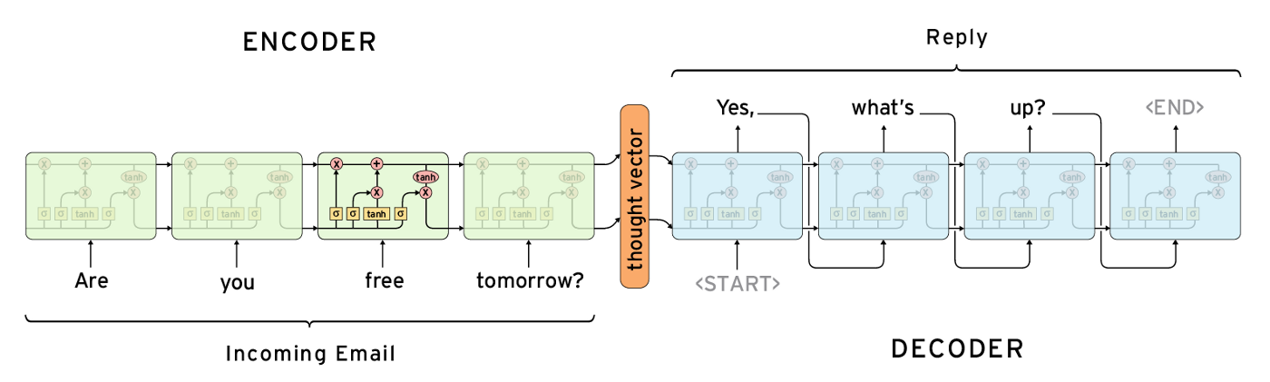
Generative Model Chatbots

Slide 11

Building Encoder
Input Layer : Takes the English sentence and pass it to the embedding layer.
Embedding Layer : Takes the English sentence and convert each word to fixed size vector
First LSTM Layer : Every time step, it takes a vector that represents a word and pass its output to the next layer.
Second LSTM Layer : It does the same thing as the previous layer, but instead of passing its output, it passes its states to the first LSTM layer of the decoder .

Slide 12
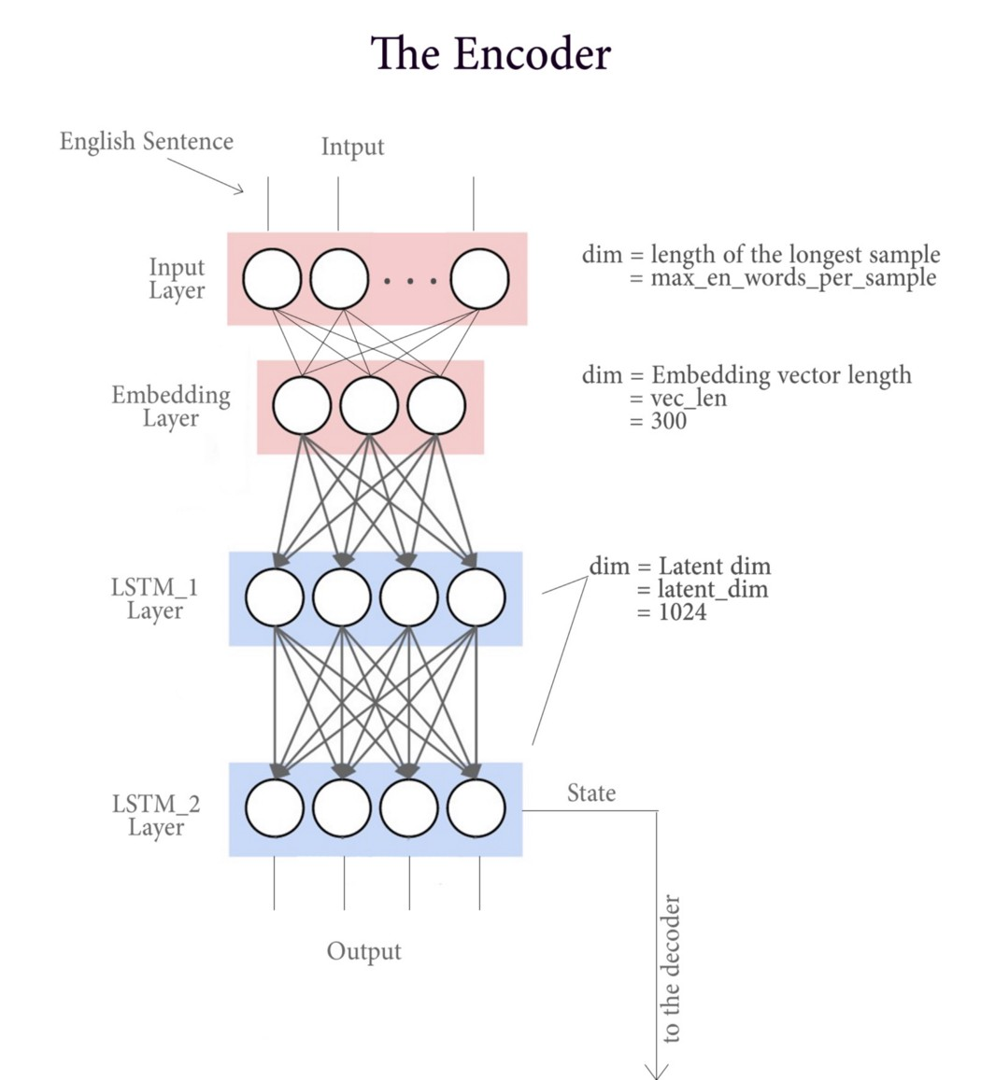
Building Encoder

Slide 13
Building Decoder
Input Layer : Takes the French sentence and pass it to the embedding layer.
Embedding Layer : Takes the French sentence and convert each word to fixed size vector
First LSTM Layer : Every time step, it takes a vector that represents a word and pass its output to the next layer, but here in the decoder, we initialize the state of this layer to be the last state of the last LSTM layer from the decoder .
Second LSTM Layer : Processing the output from the previous layer and passes its output to a dense layer .
Dense Layer (Output Layer) : Takes the output from the previous layer and outputs a one hot vector representing the target French word.

Slide 14
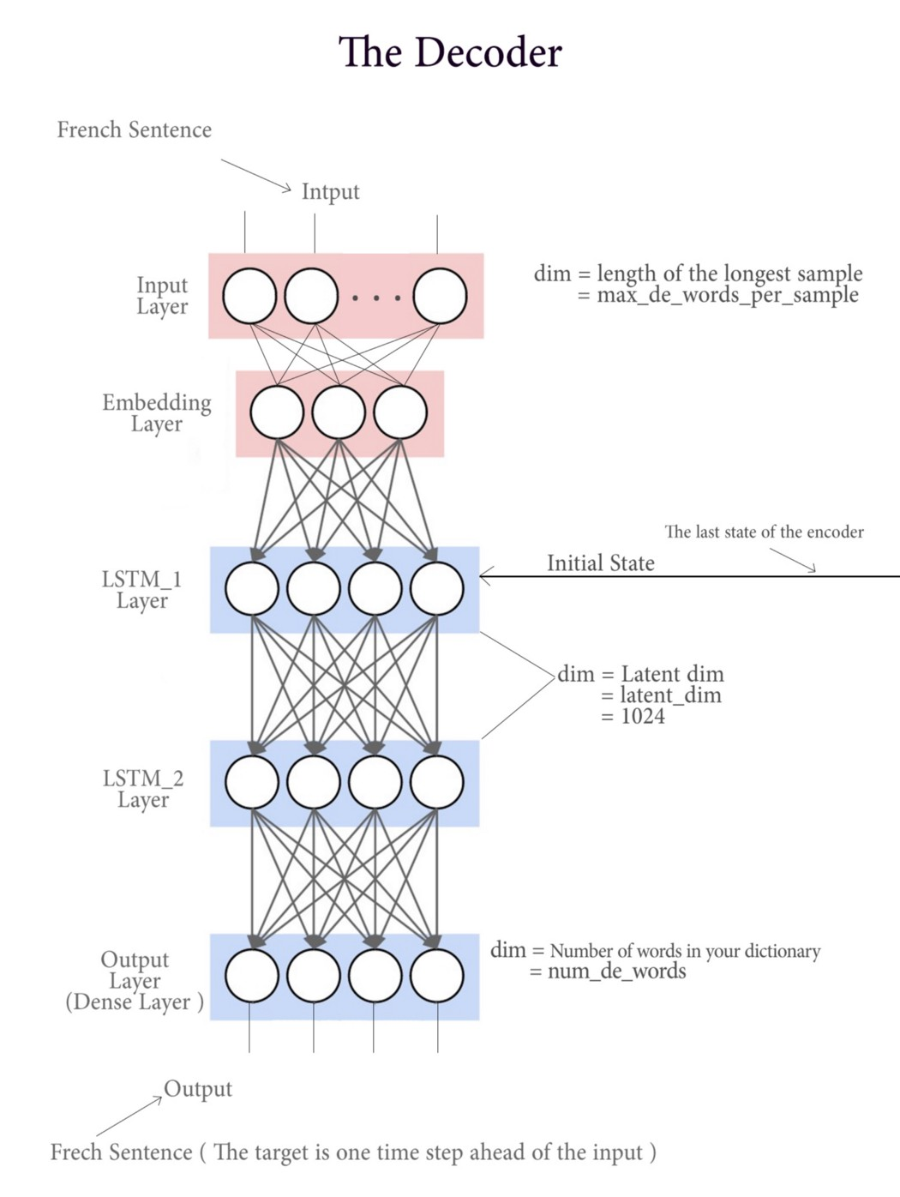
Building Decoder

Slide 15
Applications of Encoder-Decoder LSTMs
Machine Translation, e.g. English to French translation of phrases.
Learning to Execute, e.g. calculate the outcome of small programs.
Image Captioning, e.g. generating a text description for images.
Conversational Modeling, e.g. generating answers to textual questions.
Movement Classification, e.g. generating a sequence of commands from a sequence of gestures.

